Slide 1

Syllogisms: classical and modern aspects and key concepts
MARCH2021
With examples
Poplavskyi Vladislav DA-92

Slide 2
Introduction
For centuries the Aristotelian syllogisms have been a crucial part of university
courses introducing basic logic and human reasoning. In the medieval univer-
sities, syllogistics was regarded as an essential component of basic academic
learning. At many modern universities this is still the view.
There is, obviously, a close relation between the ontological primitives (e.g.,
SubclassOf) and the categorical statements which are used in classical syllogis-
tics. In fact, a number of syllogistic arguments can be inferred from the hier-
archical structures used in formal ontology (see [4]). It appears to be evident
that a proper understanding of conceptual structures in many cases will depend
on the ability to handle basic syllogistic arguments correctly. Based on such
observations syllogistic reasoning should still be considered to be an important
prerequisite for the understanding of conceptual structures and indeed for sci-
ence in general. For mathematics, syllogistics can be said to form part of the
foundation for mathematics as such. For engineering, a basic knowledge of syllo-
gistics could enhance the potential for systematic reasoning about the artefacts
being constructed. For this reason, it is our view that students working with
science, technology, engineering, and mathematics – as well as students in the
humanities – should be introduced to these basic forms of logic and reasoning

Slide 3
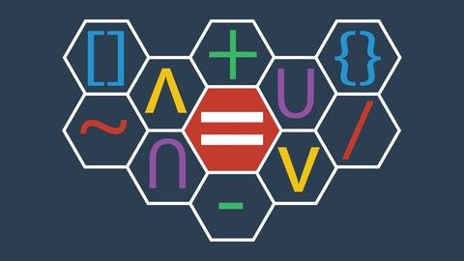
A syllogism
a kind of logical argument that applies deductive reasoning to arrive at a conclusion based on two or more propositions that are asserted or assumed to be true.
a form of deductive reasoning where you arrive at a specific conclusion by examining two other premises or ideas. Syllogism derives from the Greek word syllogismos, meaning conclusion or inference.

Slide 4
Types of Syllogism
Categorical Syllogism
As we know, our first example about roses was a categorical syllogism. Categorical syllogisms follow an "If A is part of C, then B is part of C" logic.
Let's look at some more examples of syllogism.
All cars have wheels. I drive a car. Therefore, my car has wheels.
Major Premise: All cars have wheels.
Minor Premise: I drive a car.
Conclusion: My car has wheels.
All insects frighten me. That is an insect. Therefore, I am frightened.
Major Premise: All insects frighten me.
Minor Premise: That is an insect.
Conclusion: I am frightened.

Slide 5
Types of Syllogism
Conditional Syllogism
Conditional syllogisms follow an "If A is true, then B is true" pattern of logic. They're often referred to as hypothetical syllogisms because the arguments aren't always valid. Sometimes they're merely an accepted truth.
If Katie is smart, then she will get into a good college.
Major premise: Katie is smart.
Minor premise: Because she is smart Katie will get good grades.
Conclusion: Katie will get into a good college.
If Richard likes Germany, then he must drive an Audi.
Major premise: Richard likes Germany.
Minor premise: Richard likes all German things.
Conclusion: Richard drives a German car.

Slide 6
Types of Syllogism
Disjunctive Syllogism
Disjunctive syllogisms follow a "Either A or B is true, if it's A, B is false" premise. They don't state if a major or minor premise is correct. But it's understood that one of them is correct.
This cake is either red velvet or chocolate.
It's not chocolate.
This cake is red velvet.
On the TV show Outlander, Claire's husband is either dead or alive.
He's not alive.
Claire's husband is dead.

Slide 7
Types of Syllogism
Enthymemes
An enthymeme is not one of the major types of syllogism but is what's known as rhetorical syllogism. These are often used in persuasive speeches and arguments.
Generally, the speaker will omit a major or minor premise, assuming it's already accepted by the audience.
He couldn't have stolen the jewelry. I know him.
Major Premise: He couldn't have stolen the jewelry.
Minor Premise: I know his character.
Her new purse can't be ugly. It's a Louis Vuitton.
Major Premise: Her new accessory can't be ugly.
Minor Premise: It's made by famous designer Louis Vuitton.
In an enthymeme, one premise remains implied. In the examples above, being familiar with someone or something implies an understanding of them.

Slide 8
Types of Syllogism
Syllogistic Fallacy
Some syllogisms contain false presumptions. When you start assuming one of the major or minor premises to be true, even though they're not based in fact - as with disjunctive syllogisms and enthymemes - you run the risk of making a false presumption.
All crows are black. The bird in my cage is black. Therefore, this bird is a crow.
Major Premise: All crows are black.
Minor Premise: The bird in my cage is black.
Conclusion: This bird is a crow.
The scenery in Ireland is beautiful. I'm in Ireland. Therefore, the scenery must be beautiful.
Major Premise: The scenery in Ireland is beautiful.
Minor Premise: I'm in Ireland.
Conclusion: The scenery is beautiful.
Of course, not every black bird is a crow and not all of Ireland is beautiful. When preparing a speech or writing a paper, we must always make sure we're not making any sweeping generalizations that will cause people to make false presumptions.

Slide 9
Rules of Syllogism
There are six known rules of syllogism. However, they mainly apply to categorical syllogism, since that is the only category that requires three components: major premise, minor premise, conclusion. Here are six rules that will ensure you're making a strong and accurate argument.
Rule One: There must be three terms: the major premise, the minor premise, and the conclusion - no more, no less.
Rule Two: The minor premise must be distributed in at least one other premise.
Rule Three: Any terms distributed in the conclusion must be distributed in the relevant premise.
Rule Four: Do not use two negative premises.
Rule Five: If one of the two premises are negative, the conclusion must be negative.
Rule Six: From two universal premises, no conclusion may be drawn.

Slide 10
Persuasive Speeches and Writing
Understanding syllogisms will help you create masterful persuasive speeches and essays. They create a formula for you to abide by, in order to ensure your main point is flawless.
Syllogisms also allow you to test your theories according to syllogistic fallacies. When examining your main argument or point for discussion, be sure you haven't made any presumptions that your audience might disagree with.
Maybe some women won't like MKZs. Perhaps they prefer a good 'ol fashioned Mustang! Just keep your eyes and ears open while you allow syllogisms to drive your point home with clarity and truth.

Slide 11
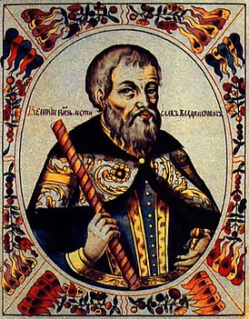
Thank You!
Poplavskyi Vladyslav DA-92

